Slide 1


Project Title : Smart AI Platform for Multilingual Legal Document Classification , Summarization and Retrieval
(Managed by Anjuman Hami-E-Islam, Nagpur)
ANJUMAN COLLEGE OF ENGINEERING AND TECHNOLOGY
SADAR, NAGPUR -440001
Department of Artificial Intelligence Data Science
Session : 2026-27
7th semester
PRESENTED BY :
7 LAIBA NAAZ AJAZ KHAN GUIDED BY :
10 MUNIRA FIRDOS DR. SYED IRFAN ALI
17 ADIBA ISHAQUE SHEIKH
28 ALKAIF INAYATULLA PATHAN Co - GUIDED BY :
35 KHAN ARSALAN MUKIM PROF. NEHA BHAGAT
54 ARYA PRAVIN TIWADE
58 SANOBAR KHAN

Slide 2
INTRODUCTION
The legal sector generates a large number of documents such as judgments, FIRs, petitions, contracts, and court orders every day.
Manual processing of these documents is time-consuming and requires significant human effort.
Artificial Intelligence (AI) and Natural Language Processing (NLP) can help automate legal document analysis.
AI-based legal systems can improve the speed, accuracy, and efficiency of legal information processing.

Slide 3
LITERATURE REVIEW
Ref. NO | PAPER TITLE | NAME OF ALGORITHM | ADVANTAGES | DIS – ADVANTAGES
1 | S. Gupta, V. Agrawal, Y. Negi, S. Karunanithi, and A. Balakrishnan, "Reducing Hallucinations in Legal AI: A Retrieval-Augmented Generation Based Model for Accurate Legal Guidance," IEEE Access, 2026 | Retrieval-Augmented Generation (RAG), Vector Embeddings, Semantic Search, Large Language Models (LLMs) Prompt Engineering | Reduces AI hallucinations, Improves reliability of legal responses, Supports semantic legal search using verified Indian Legal documents | Focuses only on legal question answering, Evaluated on a small dataset, lacks document classification, summarization, and multilingual processing

Slide 4
LITERATURE REVIEW
Ref. NO | PAPER TITLE | NAME OF ALGORITHM | ADVANTAGES | DIS – ADVANTAGES
2 | K. S. Rosamma, N. Patil, and C. D. Jaidhar, "Efficient and Fair Legal Judgment Classification via Personalized GraphRank Summarization and Class-Balanced Learning," IEEE Access. 2026 | GraphRank (PGR) TF-IDF (Term Frequency–Inverse Document Frequency) Personalized PageRank, MMR (Maximal Marginal Relevance) DeBERTa-v3, Class-Balanced Learning | Improves legal judgment summarization and classification accuracy; effectively handles class imbalance | Evaluated on European legal judgments; lacks multilingual support, semantic retrieval, and integrated legal intelligence platform

Slide 5
Ref. NO | PAPER TITLE | NAME OF ALGORITHM | ADVANTAGES | DIS – ADVANTAGES
3 | N. Chalkidis et al., "Legal Natural Language Processing from 2015–2022: A Comprehensive Systematic Mapping Study of Advances and Applications," 2023. | Systematic Mapping Study (SMS), Literature Review, Analysis of Legal NLP tasks, datasets and models | Provides a comprehensive overview of Legal NLP techniques, datasets, applications. Identifies major research trends and gaps | Survey paper only; no implementation or evaluation of an AI model; limited focus on multilingual and Indian legal NLP
4 | M. Siino et al., "Exploring LLMs Applications in Law: A Literature Review on Current Legal NLP Approaches“, 2025 | Systematic Literature Review (SLR), PRISMA Methodology, CASP Quality Assessment | Reviews state-of-the-art LLM applications in Legal NLP; identifies strengths, limitations, and future research opportunities | No practical implementation, mainly reviews existing studies, multilingual legal AI remains underexplored

Slide 6
Ref. NO | PAPER TITLE | NAME OF ALGORITHM | ADVANTAGES | DIS – ADVANTAGES
5 | F. Almutairy et al., "SmartLaw Advisor: AI-Powered Legal Consultation and Contract Analysis for Saudi Arabia" , 2026 | Retrieval-Augmented Generation (RAG), Google Gemini 1.5 Flash, ChromaDB, OCR, Semantic Retrieval, Prompt Engineering | Accurate legal consultation, contract analysis, retrieval-grounded responses, Reduces hallucinations | Designed for Saudi legal system, limited evaluation dataset, does not support multilingual Indian legal document intelligence
6 | M. M. Alsharif et al., "CHRExpert: An AI-Driven Court of Human Rights Expert Assistant for Legal Practitioners Utilizing Transformer Models," 2024. | GPT-J Transformer, Transfer Learning, NLP, Byte Pair Encoding (BPE), Multi-Head Attention, PyTorch DDP | Automates legal document analysis, legal issue identification, precedent comparison, judicial outcome prediction | Restricted to ECHR human rights cases; no multilingual Indian support; lacks integrated summarization and semantic retrieval

Slide 7
Problem Statement
India's legal system faces a significant backlog of over 5 crore pending cases. A major contributor is the manual effort required to process complex, voluminous legal documents in multiple languages. Currently, no scalable AI platform exists that can classify and summarize legal documents in a multilingual Indian context. There is an urgent need for a domain-specific, AI-enabled legal document intelligence platform that can automate classification, summarization, and facilitate efficient information retrieval from legal documents.

Slide 8
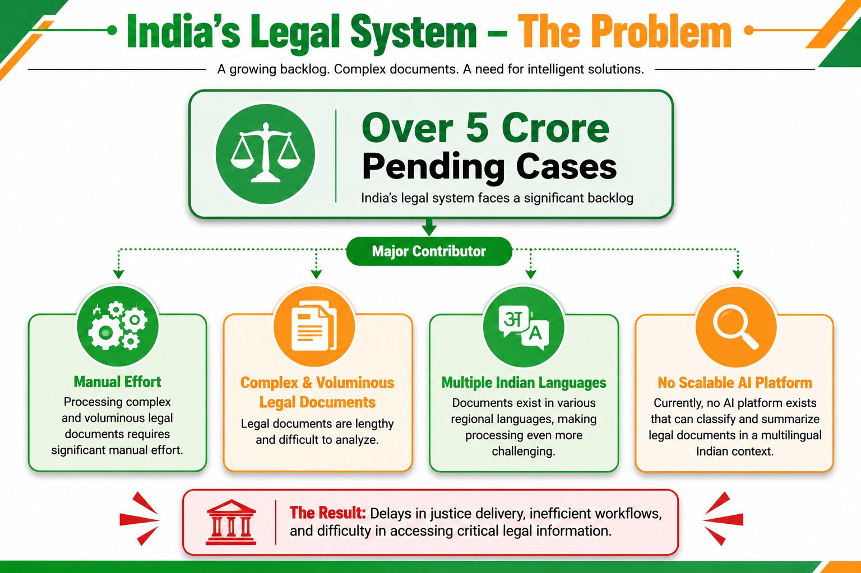
Problem Statement

Slide 9
AIM & OBJECTIVE
To develop an AI-powered platform for multilingual legal document classification, summarization, and intelligent retrieval.
Develop an AI model for automatic classification of multilingual Indian legal documents.
Build a legal documents summarizer to generate concise, structured summaries.
Design an intelligent search interface for fast, semantic legal document retrieval.
Evaluate the system with legal professionals to assess its effectiveness and usability.

Slide 10
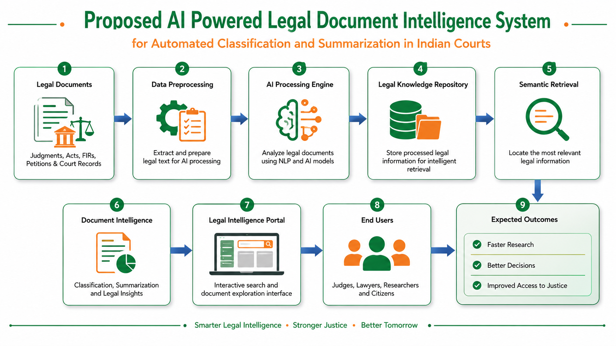
PROPOSED SYSTEM

Slide 11
SYSTEM REQUIREMENTS
Hardware
Processer: Ryzen 5/ intel i5
RAM: 8 GB or higher
Storage: 256 GB SSD or higher
Graphics: NVIDIA GPU

Slide 12

Software:
Data & Backend
Vector Database: Qdrant
Datasets: Indian Court Judgments, Indian Kanoon, eCourts, AI4Bharat IndicCorp, Legal Document Corpus
Frontend: HTML5, CSS3, React.js, Tailwind CSS
Backend: FastAPI, LangChain, LLM Integration, RAG Pipeline, REST APIs, JWT Authentication
Database : PostgreSQL
Technologies & Frameworks
Languages: Python, JavaScript
AI Technologies: AI, ML, NLP, LLM, RAG, OCR
Frameworks: FastAPI, React.js, LangChain, Hugging Face
APIs: Google Gemini, IndicTrans2, Tesseract OCR
Deployment: Docker, AWS EC2

Slide 13
ADVANTAGES
Reduces Manual Effort
Supports Multiple Indian Languages
Saves Time in Understanding Legal Documents
Efficient Legal Document Retrieval
Improves Accessibility of Legal Information
Handles Large Volumes of Legal Documents
Provides an Integrated Legal Document Platform

Slide 14
APPLICATIONS
Law Firms and Legal Practitioners
Courts and Judicial Institutions
Government Legal Departments
Legal Research and Case Preparation
Legal Education and Academic Research
Multilingual Legal Document Management

Slide 15
FUTURE SCOPE
Expansion to More Languages
Large-Scale Legal Document Processing
Advanced Legal Document Understanding
Improved OCR and Multimodal Processing
Explainable and Trustworthy Legal AI
Continuous Model Improvement
Integration with Legal Workflows

Slide 16
CONCLUSION
The proposed Smart AI Platform simplifies the classification, summarization, and retrieval of multilingual legal documents. It reduces the time and manual effort required to process large volumes of legal data while helping legal professionals quickly find and understand relevant information. By supporting multiple languages, the platform improves the accessibility, efficiency, and accuracy of legal document management, especially in the Indian legal system.

